Slide 1
Security Analysis Report on REDACTED
Savannah Chappus ~ Advanced Ethical Hacking ~ Fall 2024

Slide 2
Disclaimer 1:
To protect the identity of our client, certain details of this presentation have been obscured.
Disclaimer 2:
All of the events discussed in the scope of this report are strictly hypothetical and have not occurred in any form. They are written as if they have happened solely for the purposes of the assignment. Sources that are not explicitly cited in the body of the paper were used for researching the hypothetical scenarios.

Slide 3
01
Introduction
04
Access Control
Purpose
Scope
Active Directory Domain Audit
Outcome & Response
02
Social Engineering
05
Future Work
A G E N D A
Vishing & Phishing Scam
Outcome & Response
Future Tests
Conclusion
Questions
03
Network Security
External Domain Review
Outcome & Response
Network Traffic Monitor
Outcome & Response

Slide 4
01
Introduction

Slide 5
Introduction
Purpose
Scope
Catch security flaws
Maintain client’s integrity
Improve client’s incident response
Improve client’s overall security
Minimal strain
Low-impact
Targeted to client’s needs
Safe and manageable tests
Client
Method
Critical Infrastructure sector
REDACTED REDACTED REDACTED
Primarily ‘white-box’
Collaborated extensively with our client’s executive

Slide 6
02
Social Engineering Tests

Slide 7
Phishing & Vishing Scam Simulation
All employees except the executive
Ignored ex-employee network
Phishing & vishing only, no smishing
Randomized scripts & format
Social Engineering Test

Slide 8
Script 1
Script 2
Script 3
[Subject: Strange Logon Behavior]
Good morning [Name Name],
This is the IT department. We received an alert last night informing us of some strange logon behaviour occurring between 12:00 AM and 2:00 AM on your account. We would like you to review the list of locations and devices logged in during that time frame and verify that they all belong to you. You can access the ticket containing the list below.
[a malicious link would go here and would be very long]
This is [executive name, title]. I am on my way to an emergency meeting and left my access key at home. Can you give me your login credentials so I can quickly pull up [file]? You can reset your password immediately after if you’re concerned.
A soft, warm breeze blew through the trees, rustling the leaves gently. Birds chirped in the distance, and the sound of a distant bell rang out. People gathered in the park, chatting with each other and enjoying the peaceful sunny afternoon.
Note: This script has been kept confidential to protect the integrity of our clients as it contains information pertaining to their specific operations. In brief, the caller pretends to be a client of our client and falsely requests their services in an urgent manner. The idea behind this message would be to distract our client and to divert or strain their resources.

Slide 9
32%
of employees fell for one of the scams

Slide 10
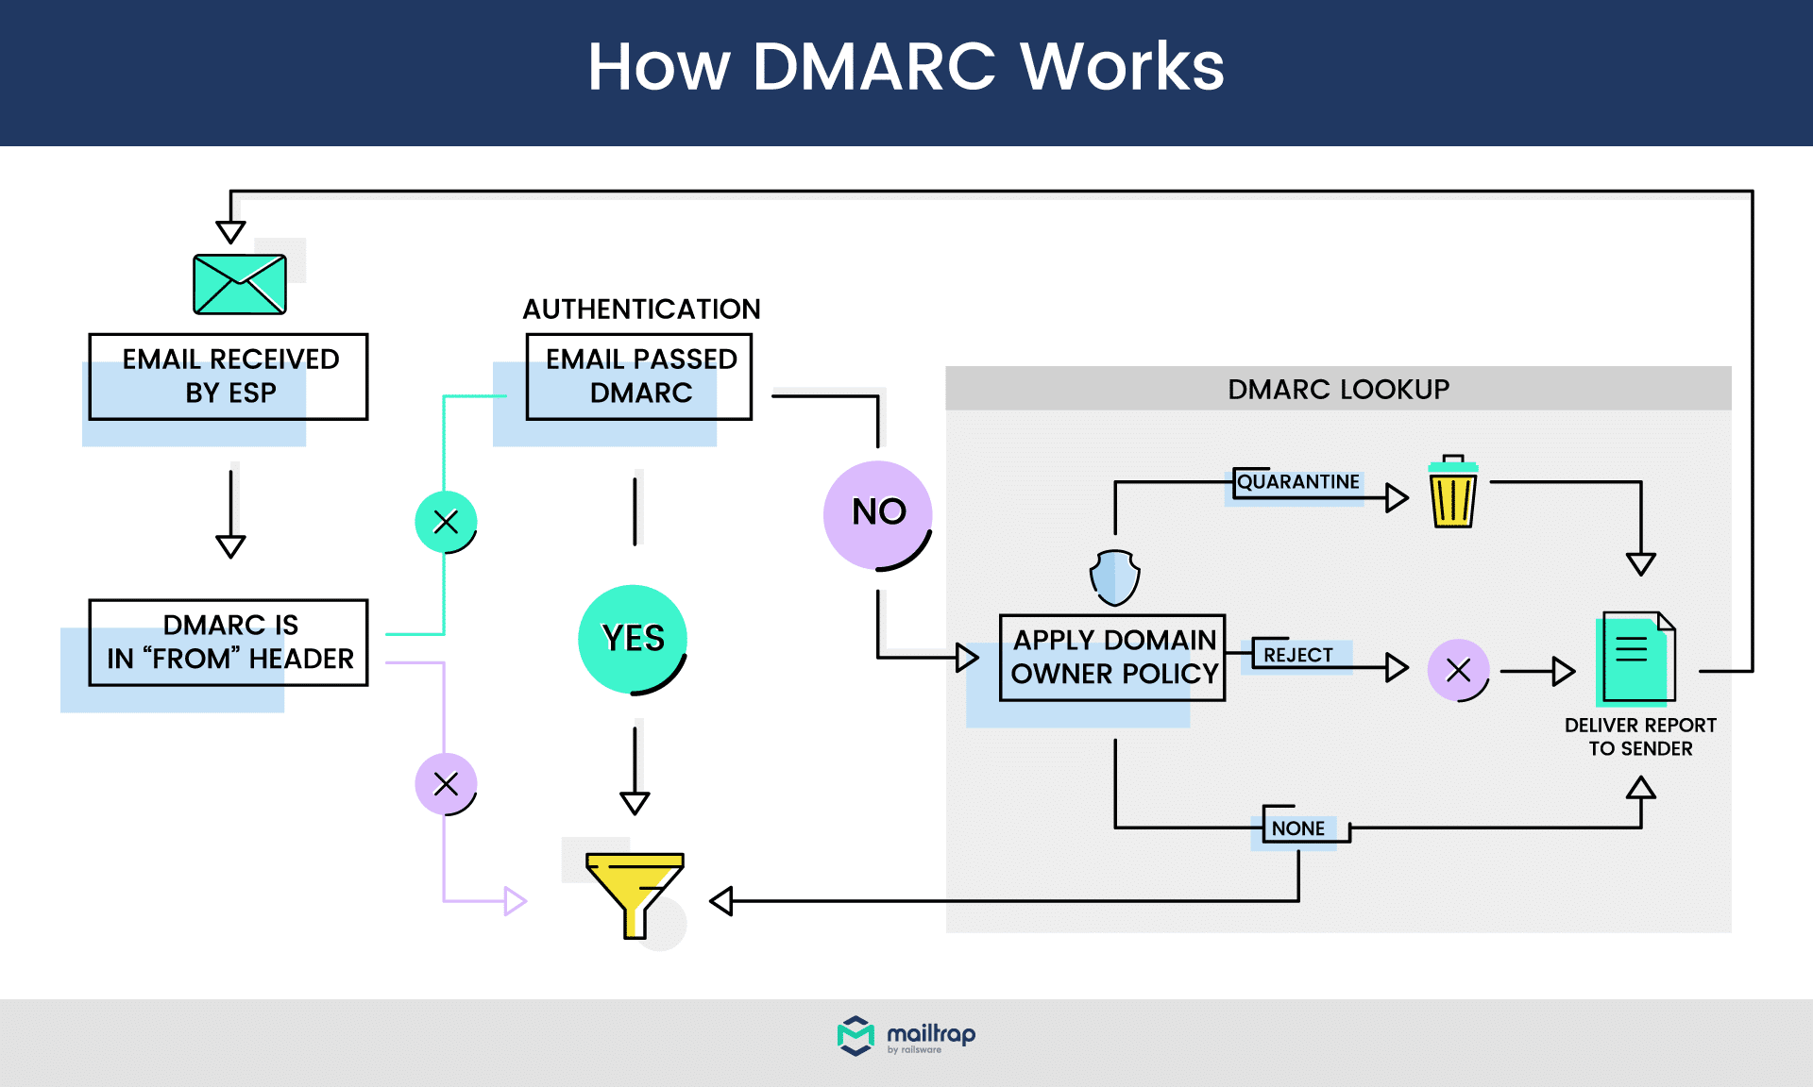
Outcome & Response
In the case of poor external risk protection policies…
In the case of poor employee training…
Implement new policies for email and call filtering
Specifically: DMARC
Implement extended training program, including…
A confidential information overview
An overview on maintaining integrity
Fraud identification exercises
Routine testing (this would continue on a monthly basis until >80% of employees passed the test, at which point we would transition to a new training program)
A thorough review, analysis, and potential refactoring of company policies on information sharing and distribution

Slide 11
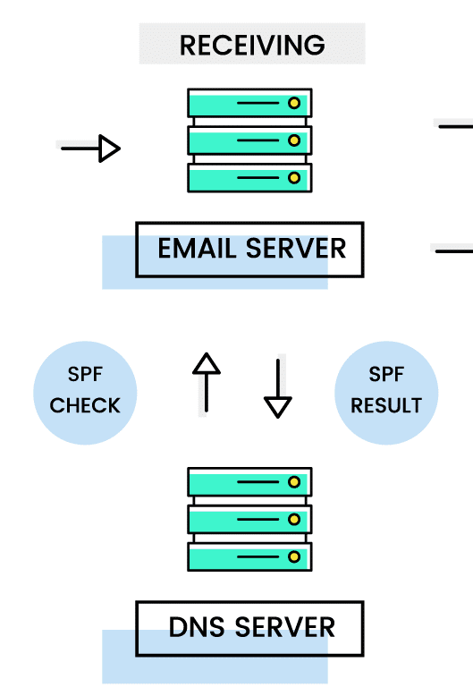
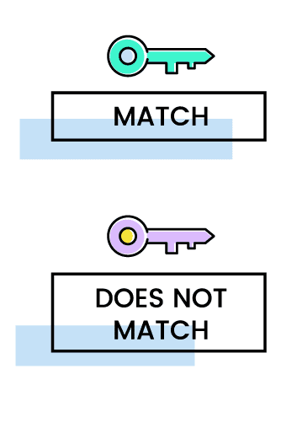
What are SPF, DKIM, and DMARC?
SPF
DKIM
DMARC
Sender Policy Framework
DomainKeys Identified Mail
Domain-based Message Authentication, Reporting, and Conformance
List of authorized IP addresses for sending emails
Recipient server checks SPF record to verify
Adds cryptographic signature to messages to verify
Public key is verified by the recipient server
Combines SPF and DKIM and specifies how to handle failures
https://www.showwcase.com/article/18431/ultimate-guide-to-email-authentication

Slide 12
03
Network Security Tests

Slide 13
External Domain Review
Brief audit of public-facing website
Focused on internal domains
Worked with client’s executive
Network Security Test 1

Slide 14
Tested Categories
DNSSEC Policy and/or Practice Statement
DNSSEC Policy and/or Practice Statement
Our client does not publish a DNSSEC policy
Incident Response Procedures
Incident Response Procedures
Our client has poorly defined incident response procedures, especially with respect to their DNSSEC operation
Geographical Diversity
Geographical Diversity
Power Continuity
Power Continuity
Trusted Roles
Trusted Roles
Our client did not specify who is responsible for DNSSEC operations
Secure DNS Instances
Secure DNS Instances
Resource Records Time-to-Live
Resource Records Time-to-Live
Our client’s policies pertaining to the maintenance of operating systems was unclear and unrefined

Slide 15
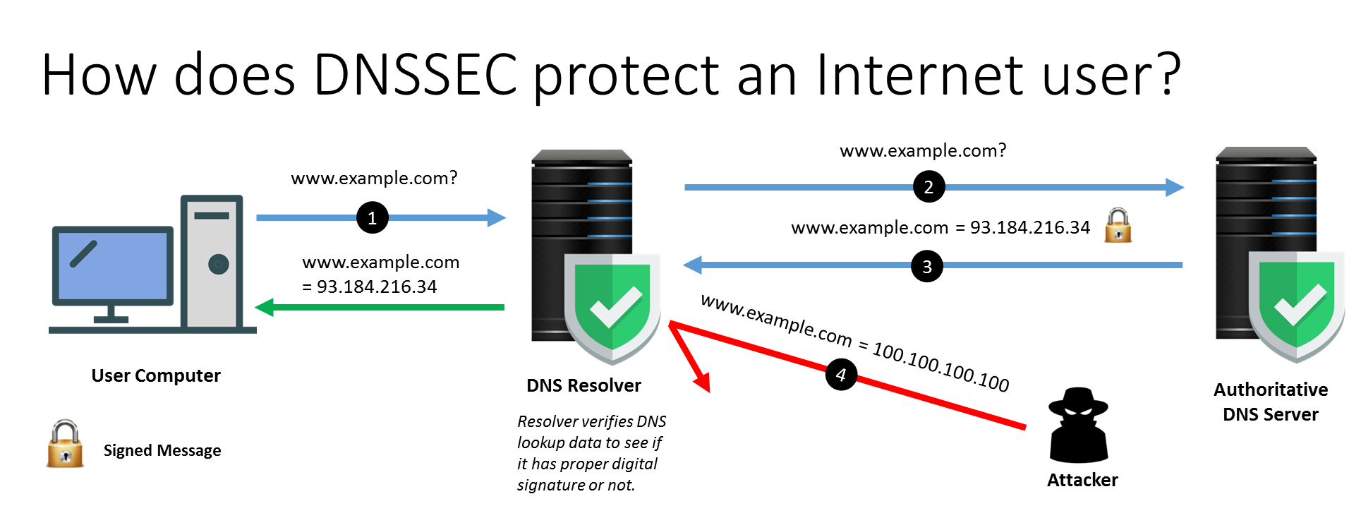
Our Recommendations
Compose and publish a DNSSEC policy
Either with us or with BlueCat
Outline DNSSEC-specific incident response procedures
Designate someone to be responsible for DNSSEC operations
We recommend the Security Officer
Clarify policies for system maintenance
https://www.infosec.gov.hk/en/best-practices/business/learning-security-of-dns

Slide 16
Network Traffic Monitoring
Peace of mind check
Week-long monitoring setup
Daily (2) check-ins on traffic
Real-time traffic flow visualization
Lightweight, non-intrusive
Network Security Test 2

Slide 17
Timeline
Week long monitoring with ntopng to establish baseline activity
Twice daily check-ins to catch anomalous behavior
Follow up with Wireshark if needed
01
M
T
W
T
F
S
S
ntopng monitoring
Daily check-in
Daily check-in
Daily check-in
Daily check-in
Daily check-in
Daily check-in
Daily check-in
Daily check-in
Daily check-in
Daily check-in
Daily check-in
Daily check-in
Daily check-in
Daily check-in
Notes:
Chose ntopng because it’s lightweight and give visualization of network flow

Slide 18
Outcome | Strategy | Reasoning
An old printer connected to the network was sending frequent update requests, which contributed to unnecessary network chatter | Update the printer’s firmware or replace with a newer model | To avoid extraneous network traffic that could slow response times and to prevent attackers from leveraging old vulnerabilities to gain access to the system
Three unauthorized personal devices were connected to the network | Disconnect all unauthorized devices from the network, implement policies for connecting devices to the network, and enforce consequences for unauthorized use | To prevent attackers from gaining easy access to the system by using personal devices with different security settings
The systems firewall rules were minimal, leading to minimal network segmentation | Update, revise, or add firewall rules to the network | To further protect the system at every point possible

Slide 19
04
Access Control Review

Slide 20
Active Directory Domain Audit
Primary operations are internal
Initial review and fixes
No simulated attacks
Manual audit process
Access Control Review Test
Notes:
Manual audit process includes tools like: Nmap, OpenLDAP, Wireshark, CLI commands, BloodHound

Slide 21
Findings
Recommended Fixes
One account with excessive privileges | Remove all unnecessary privileges from the account
Two occurrences of regular use of an elevated account for non-essential purposes | Only use accounts with elevated privileges for elevated uses
One account with elevated access privileges that was no longer used or monitored | Remove the unused account from the domain. Additionally, schedule regular checks for inactive accounts
Six easily crackable passwords | Change weak passwords immediately, and implement a stricter password policy
Four passwords found in security breaches | Change breached passwords, monitor breached accounts for at least one month, and implement password expiration policies
Two shared accounts with no password set | Set strong passwords, even on shared accounts
One instance of a service with out-of-the-box security settings | Update the security settings to better suit client’s needs

Slide 22

Additionally…
We also suggested the use of Wazuh to our client for continued monitoring of their internal systems. Our suggestion is such for two reasons:
Wazuh is free and open source, making it a desirable low-budget security solution
Wazuh is a Security Information and Event Management tool, meaning our client can regularly monitor internal hosts to more proactively catch potential security flaws

Slide 23
05
Future Work

Slide 24
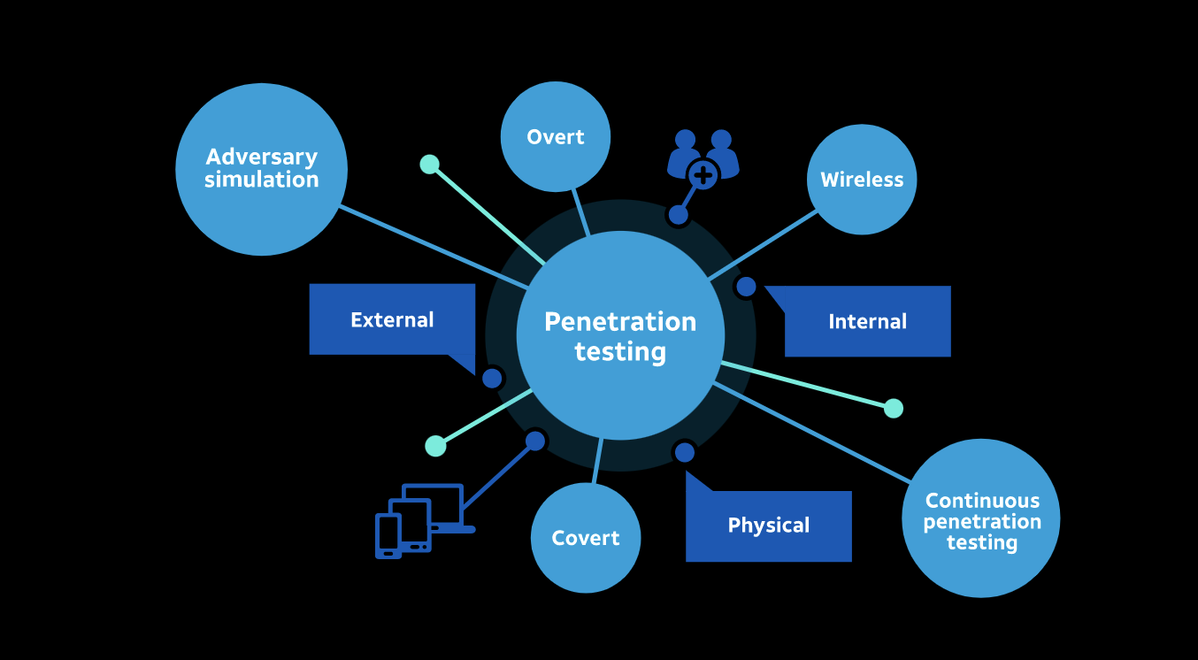
Future Testing Propositions
Static code and application analysis
Smishing scams
Attack simulations to test the new implementations in the system
Man-In-The-Middle (MITM) attacks
Denial of service attacks
Physical access control review

Slide 25
Questions?

Slide 26
Sources
Bertucci, D. (2024, November 4). Network traffic monitoring in 2024: Discover the top 7 solutions. Auvik. https://www.auvik.com/franklyit/blog/best-network-traffic-monitor/
Cichonski, P., Millar, T., Grance, T., & Scarfone, K. (2012). Computer Security Incident Handling Guide : Recommendations of the National Institute of Standards and Technology. https://doi.org/10.6028/nist.sp.800-61r2
Creating a DNSSEC signing policy. Address Manager Administration Guide. (2024). https://docs.bluecatnetworks.com/r/Address-Manager-Administration-Guide/DNSSEC-with-Address-Manager-and-DNS/DHCP-Server/9.3.0
Firch, J. (2024, February 28). Social engineering penetration testing: Attacks, methods, & steps. PurpleSec. https://purplesec.us/learn/social-engineering-penetration-testing/
Hu, V. C., & Scarfone, K. (2012). Guidelines for Access Control System Evaluation Metrics. https://doi.org/10.6028/nist.ir.7874
Hu, V. C., Ferraiolo, D. F., & Kuhn, D. R. (2006). Assessment of Access Control Systems. https://doi.org/10.6028/nist.ir.7316
Mekking, M., & Kolkman, O. (2013). (rep.). DNSSEC Infrastructure Audit Framework. Retrieved November 15, 2024, from https://www.nlnetlabs.nl/downloads/publications/dns-audit-framework-1.0.pdf.
NSA and CISA Red and Blue Teams Share Top Ten Cybersecurity Misconfigurations. Cybersecurity and Infrastructure Security Agency CISA. (2023, October 5). https://www.cisa.gov/news-events/cybersecurity-advisories/aa23-278a
Philp, M. (2022, August 4). 10 phishing email examples and why we know they’re fake. Intersys. https://intersys.co.uk/2022/08/04/10-phishing-email-examples-and-why-we-know-theyre-fake/
What are DMARC, DKIM, and SPF?. Cloudflare. (2024). https://www.cloudflare.com/learning/email-security/dmarc-dkim-spf/
Yakushkin, V. (2024, March 22). Active directory (AD) auditing: Security Tips & Best Practices. Syteca. https://www.syteca.com/en/blog/secure-active-directory-with-pam

Slide 27
THANK YOU
SAVANNAH CHAPPUS

